Slide 1
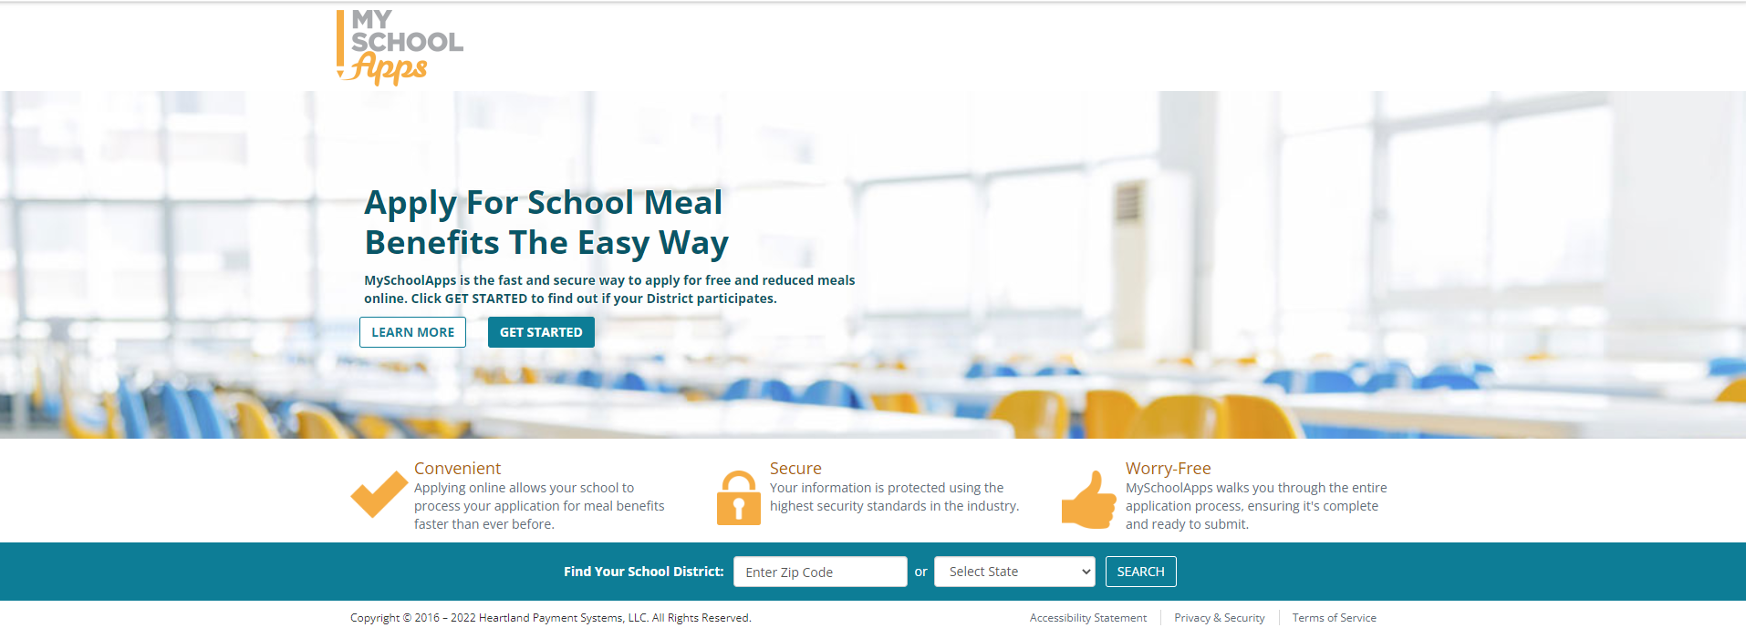
MySchoolApps Income Survey Form

Slide 2
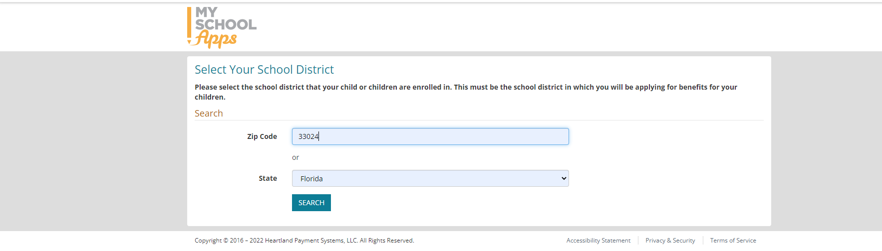
Select You District

Slide 3
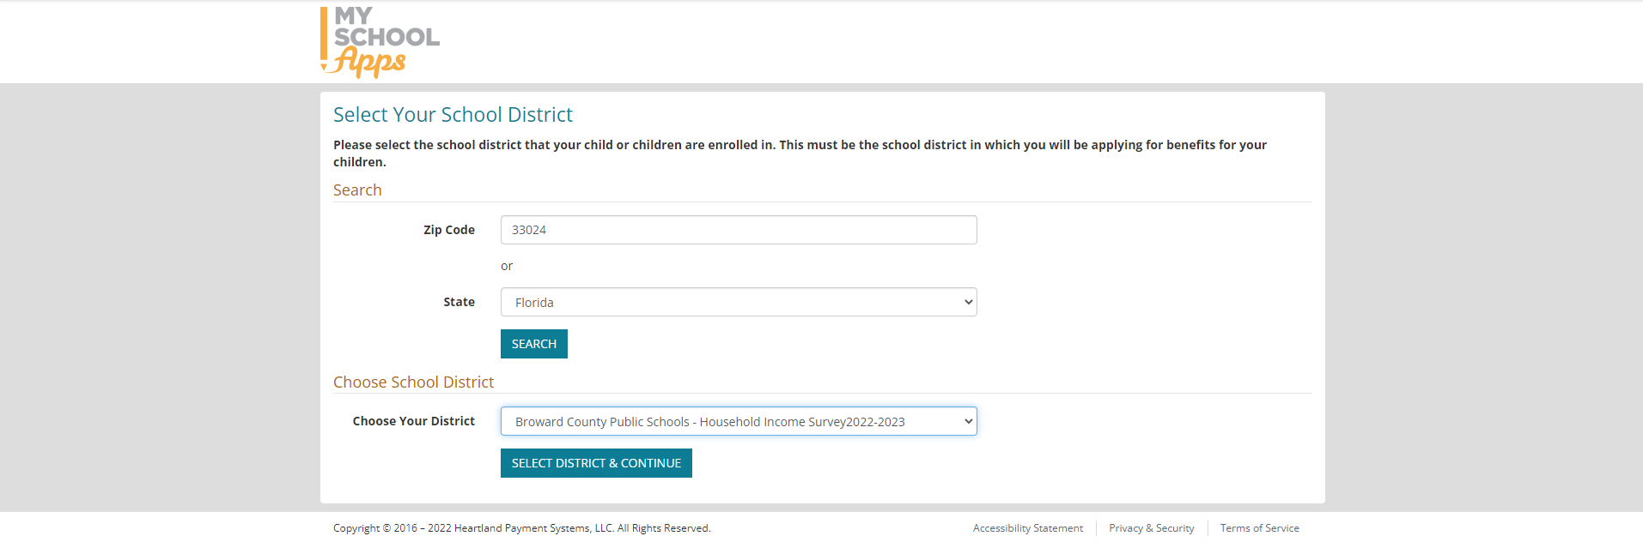
Choose School District

Slide 4
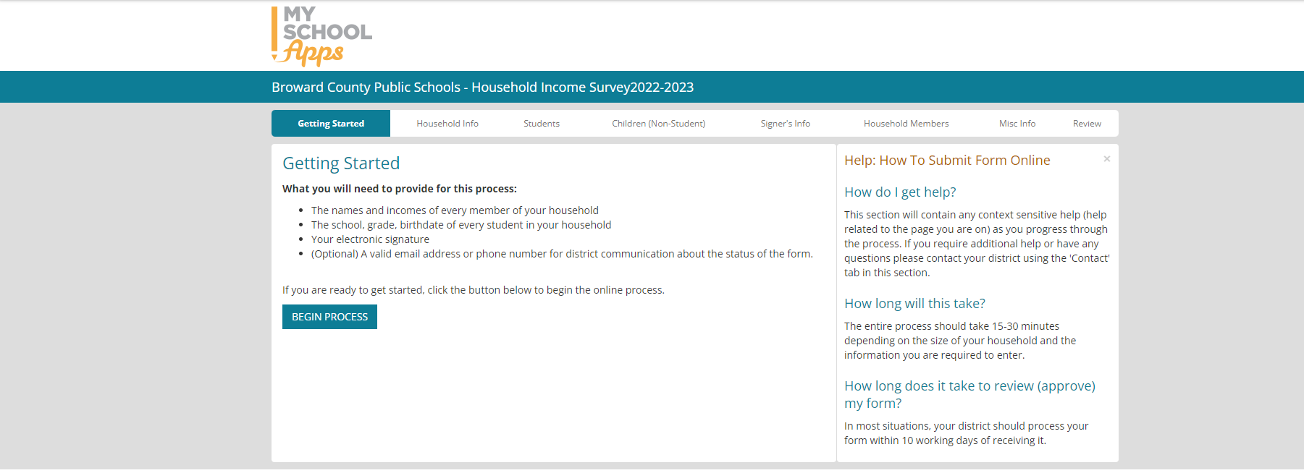
Getting Started

Slide 5
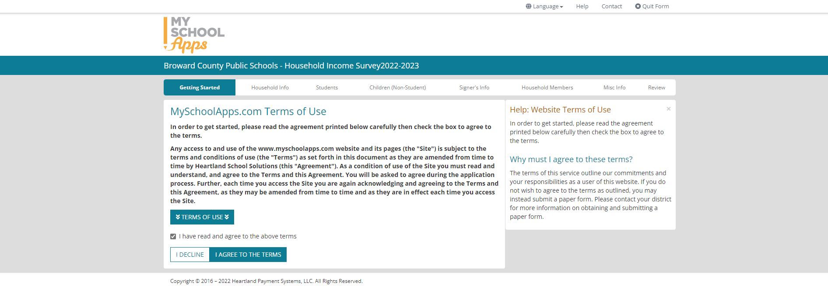
Terms of Use

Slide 6
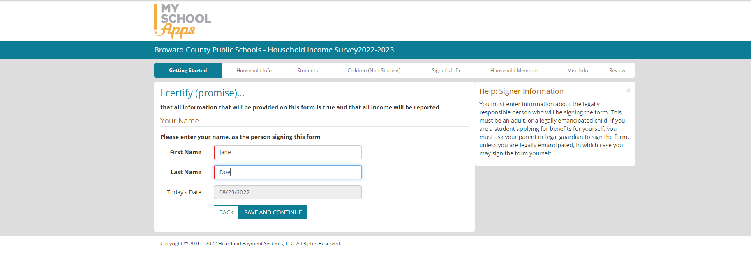
Signer Information

Slide 7
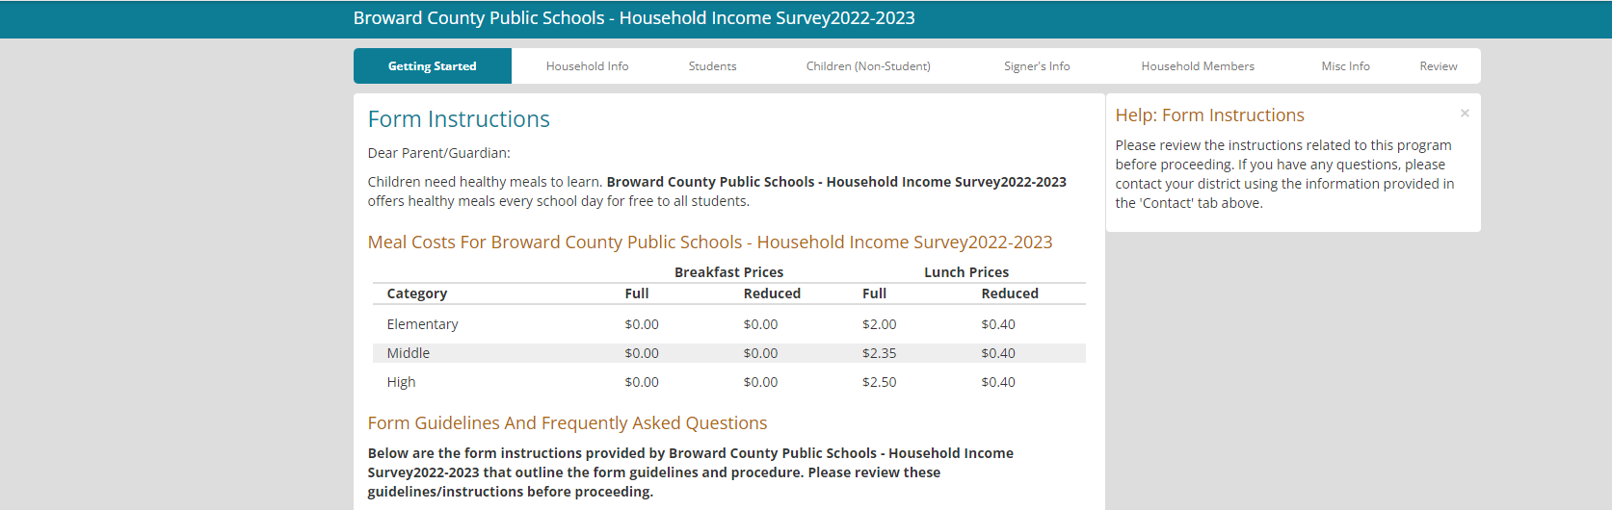
Form Instructions

Slide 8
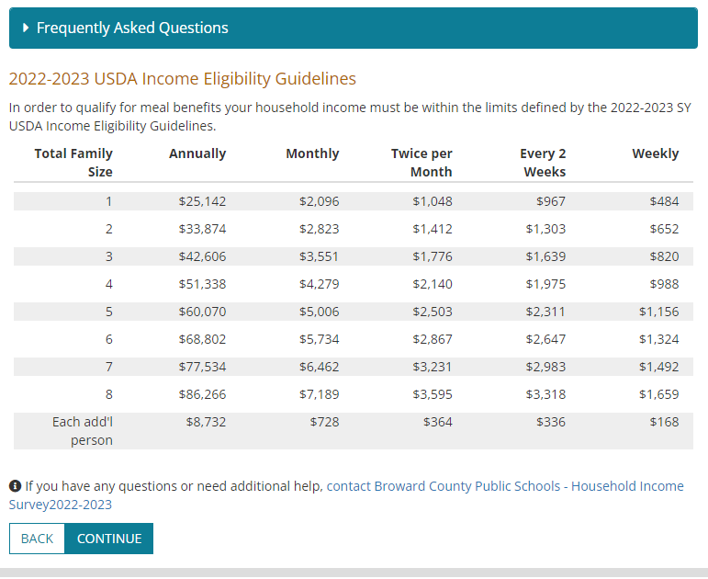
USDA Income Eligibility Guidelines

Slide 9
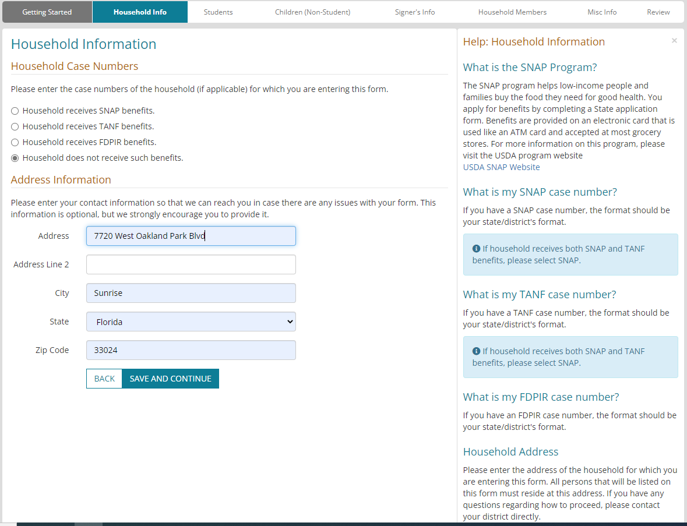
Household Information

Slide 10
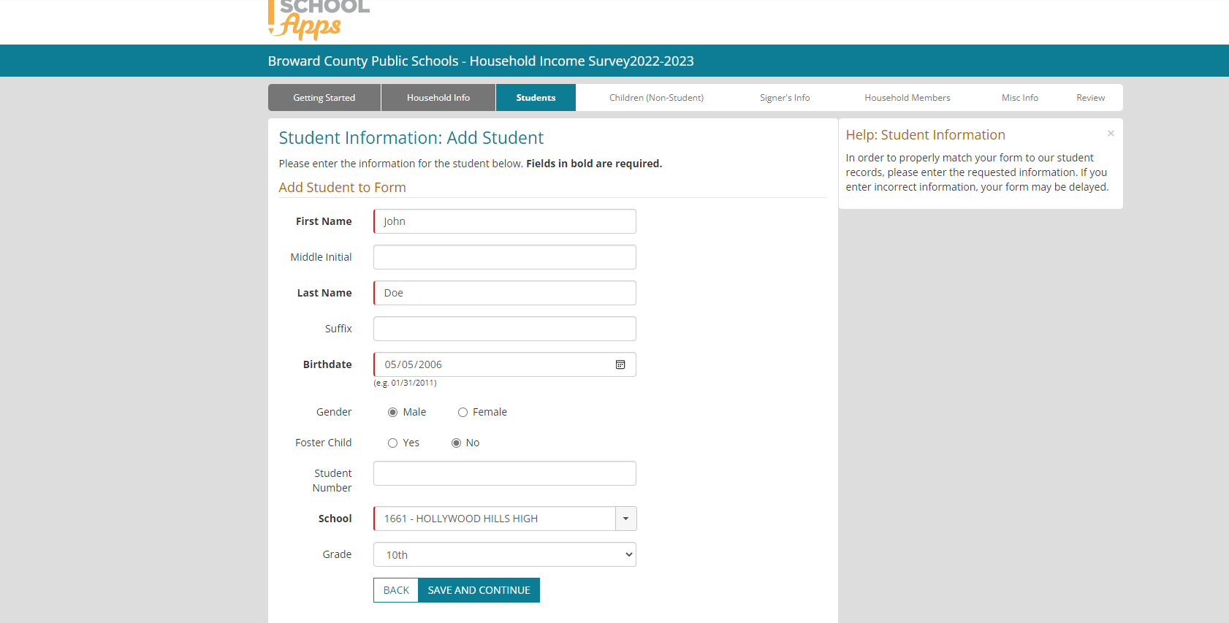
Student Information: Add Student

Slide 11
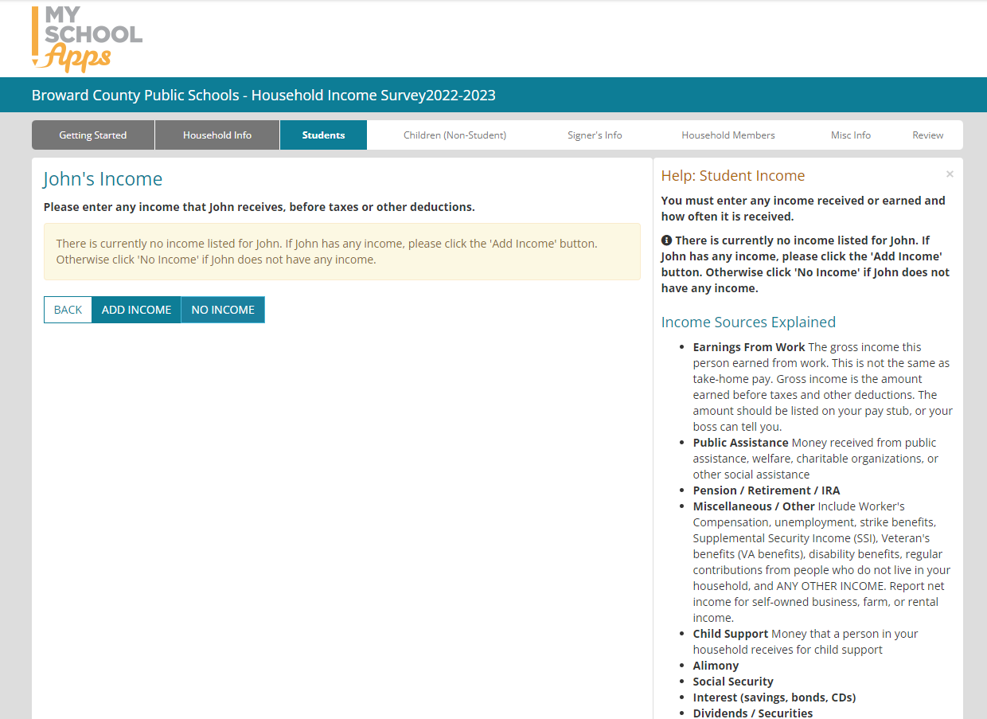
Student’s Income

Slide 12
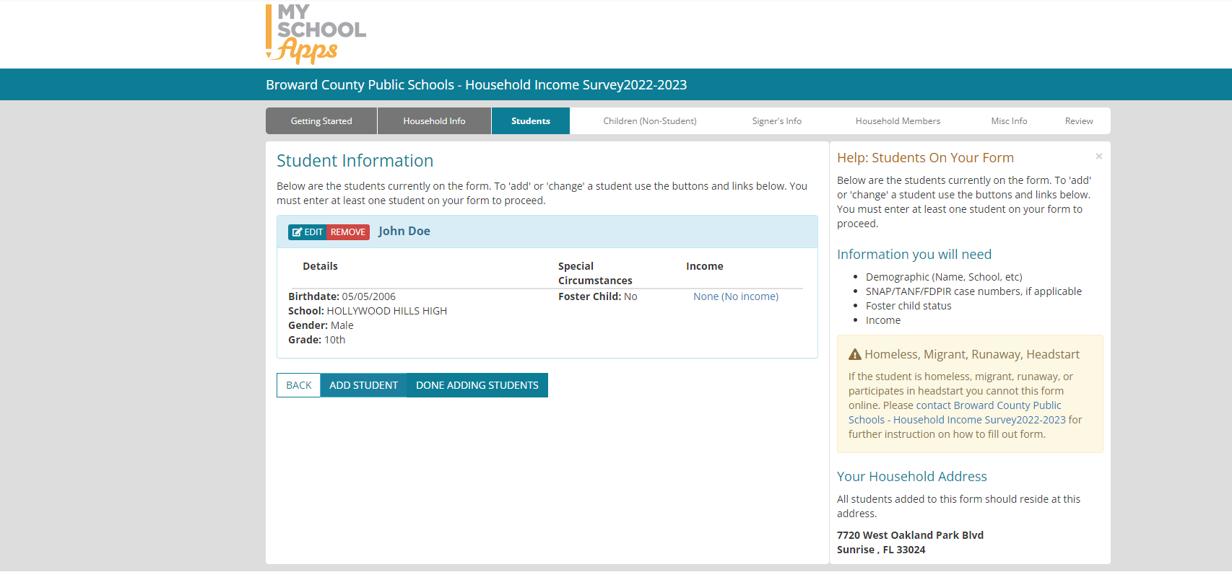
Student Information

Slide 13
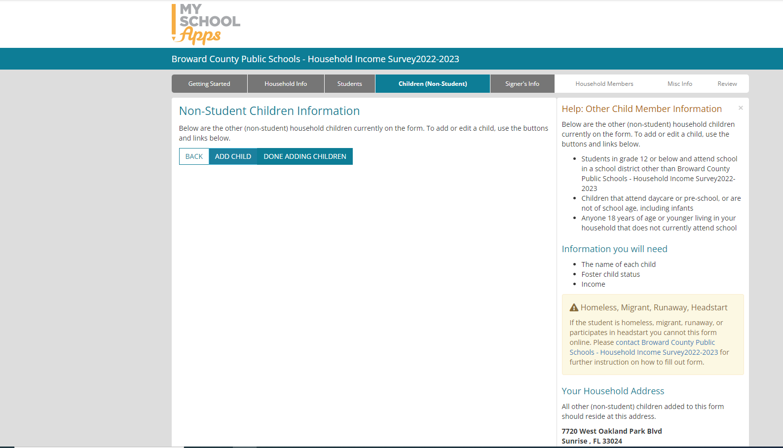
Non-Student Children Information

Slide 14
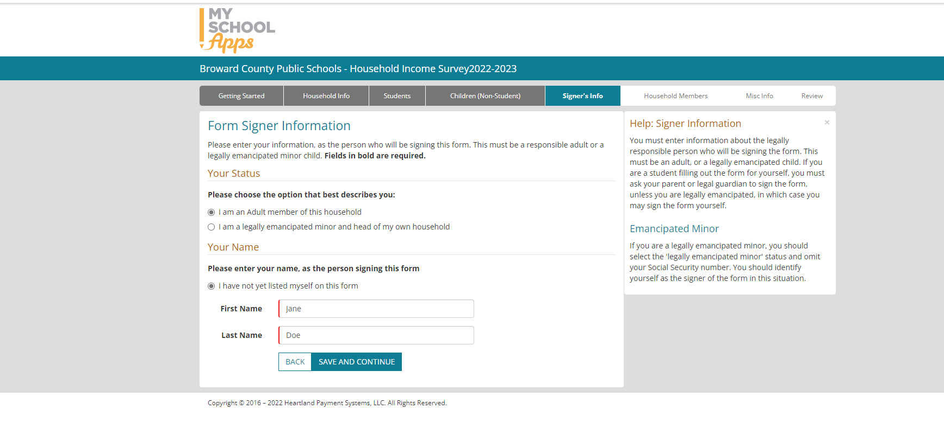
Form Signer Information

Slide 15
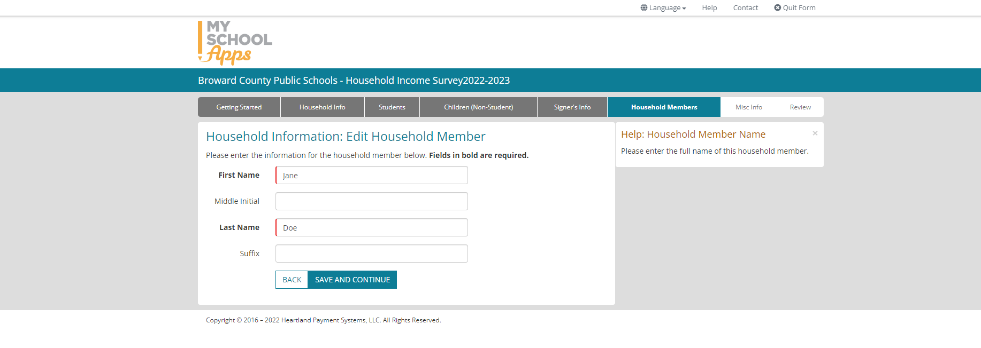
Household Information: Edit Household Member

Slide 16
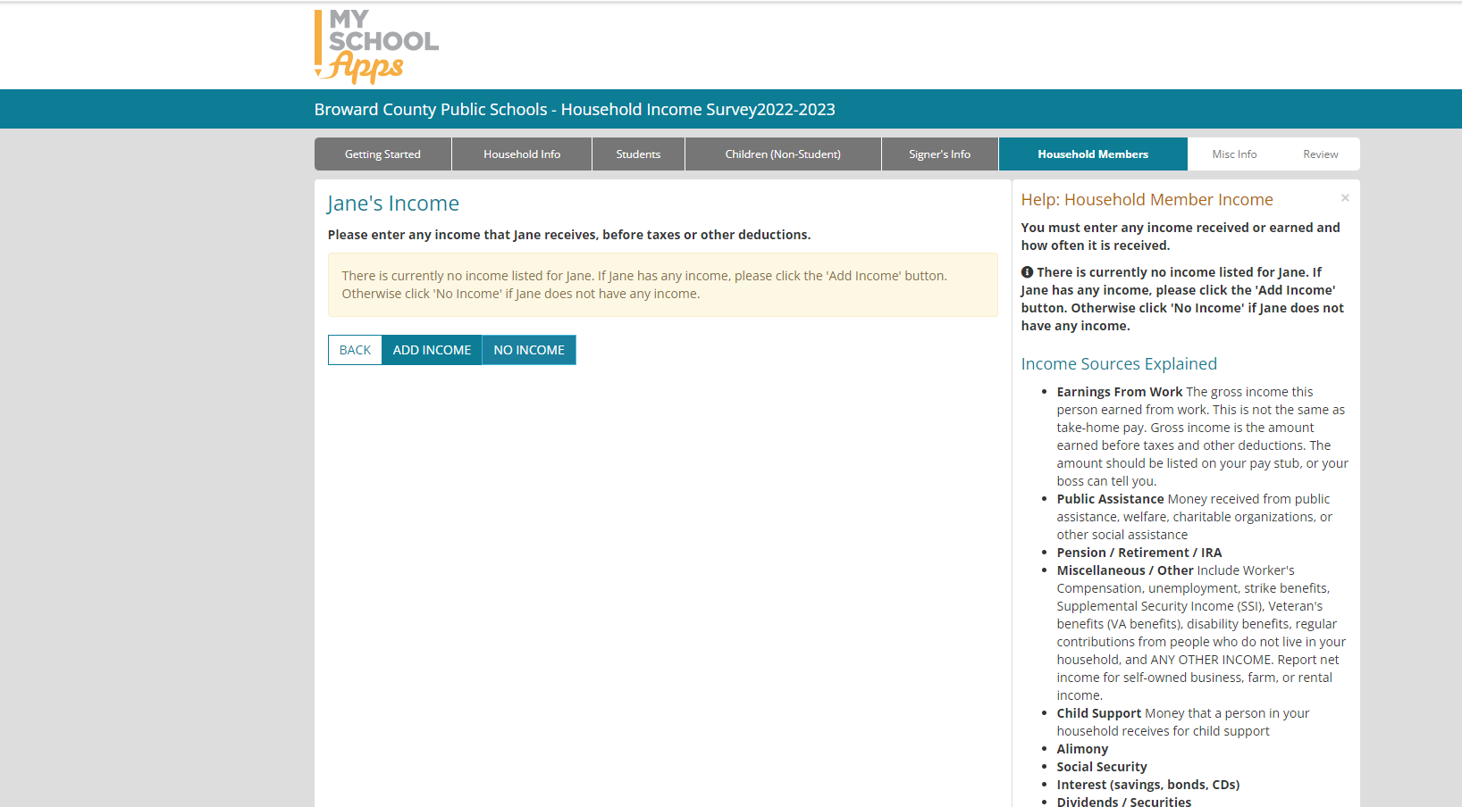
Parent’s Income

Slide 17
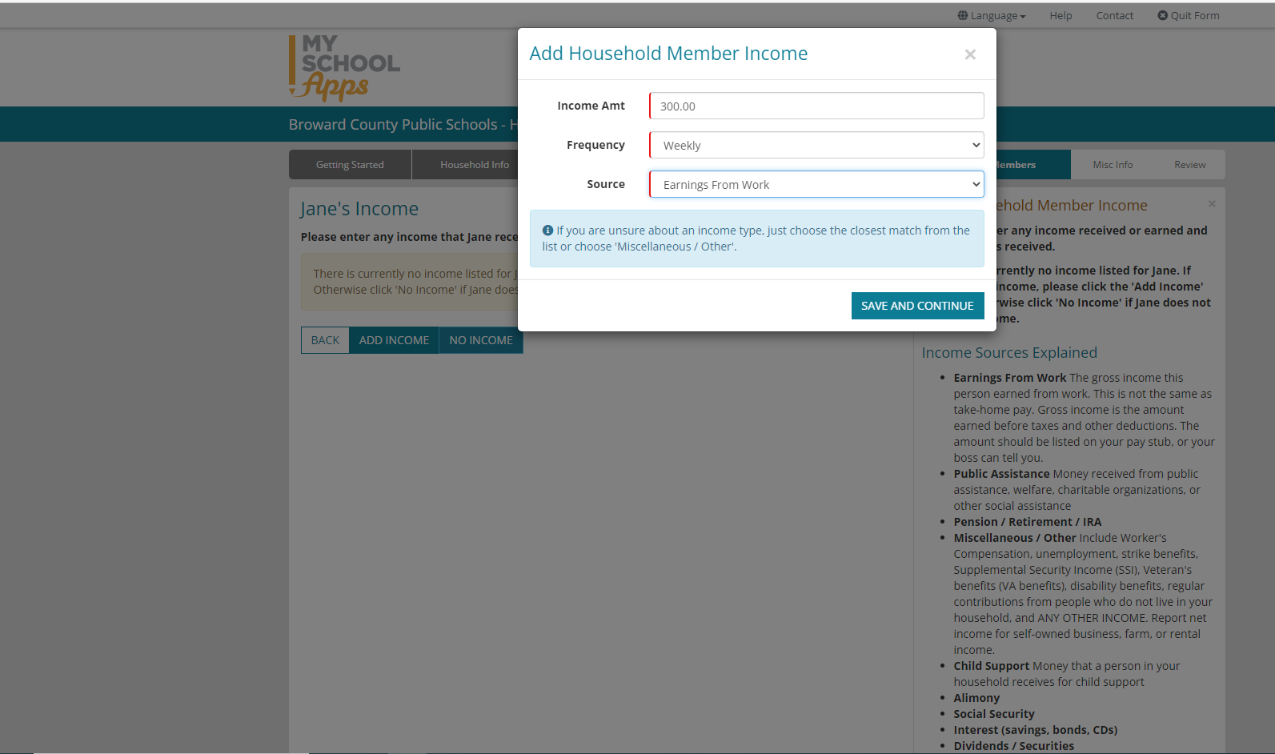
Parent’s Income

Slide 18
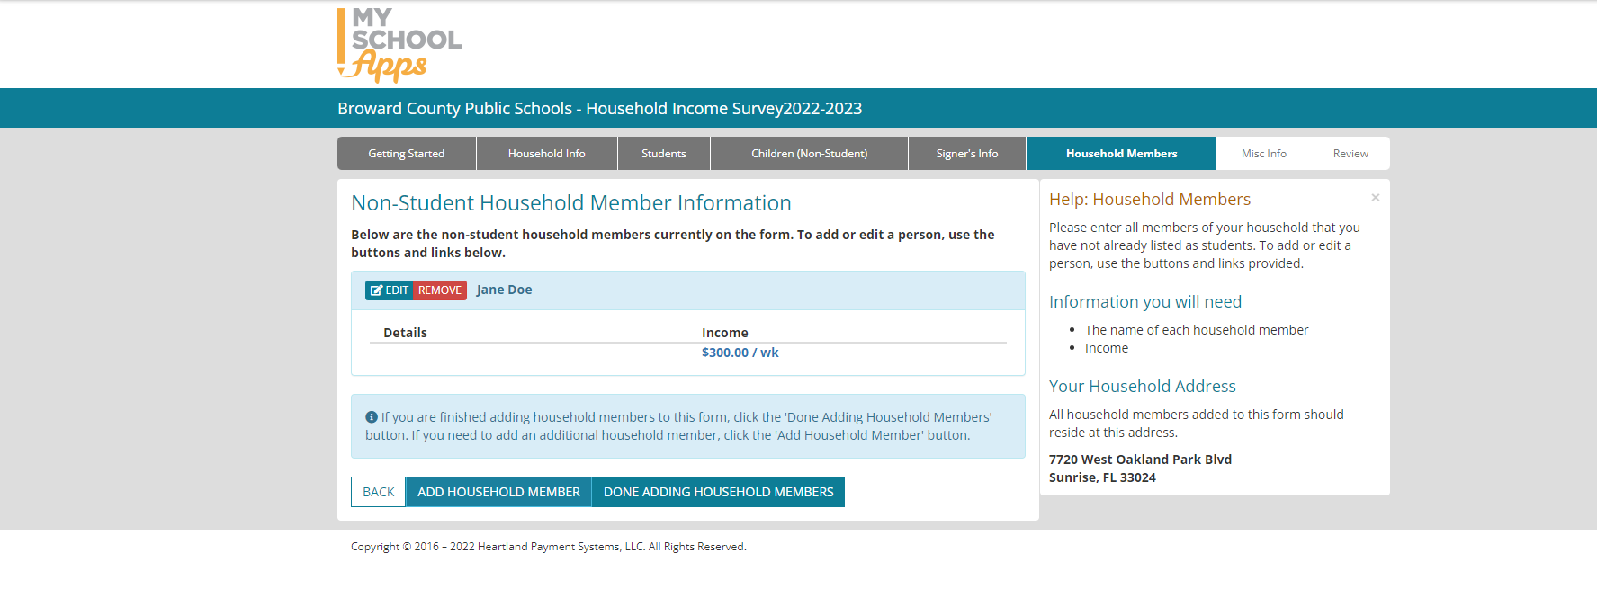
Non-Student Household Member Information

Slide 19
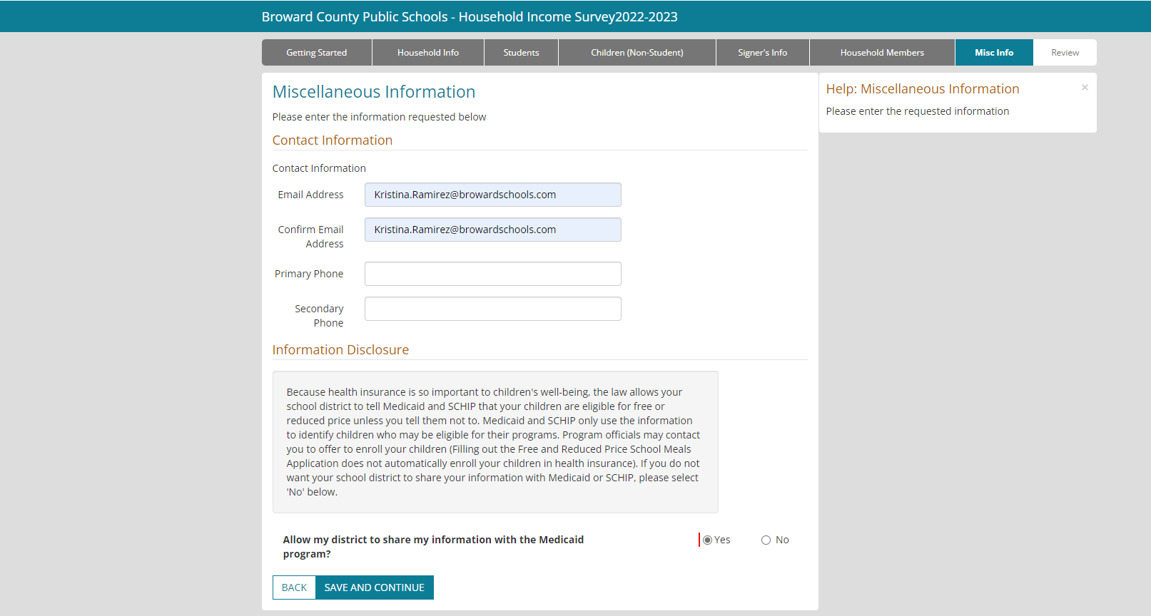
Miscellaneous Information

Slide 20
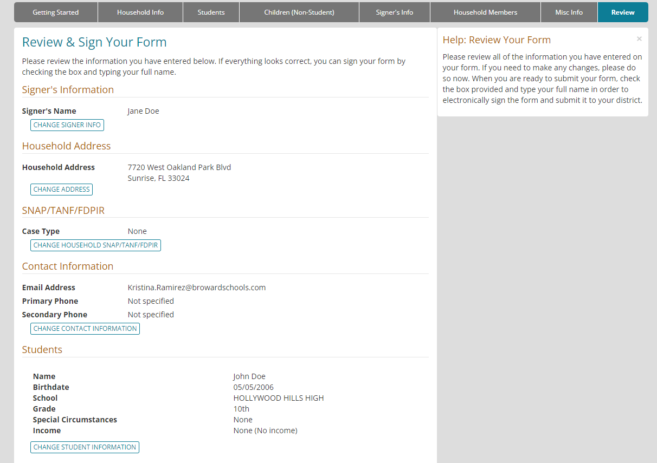
Review & Sign Your Form

Slide 21
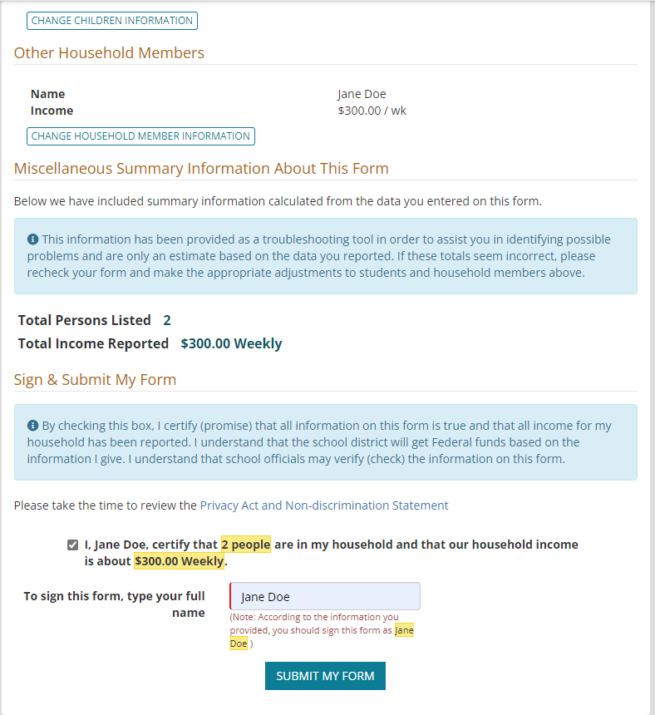
Review & Sign Your Form (conutine)

Slide 22
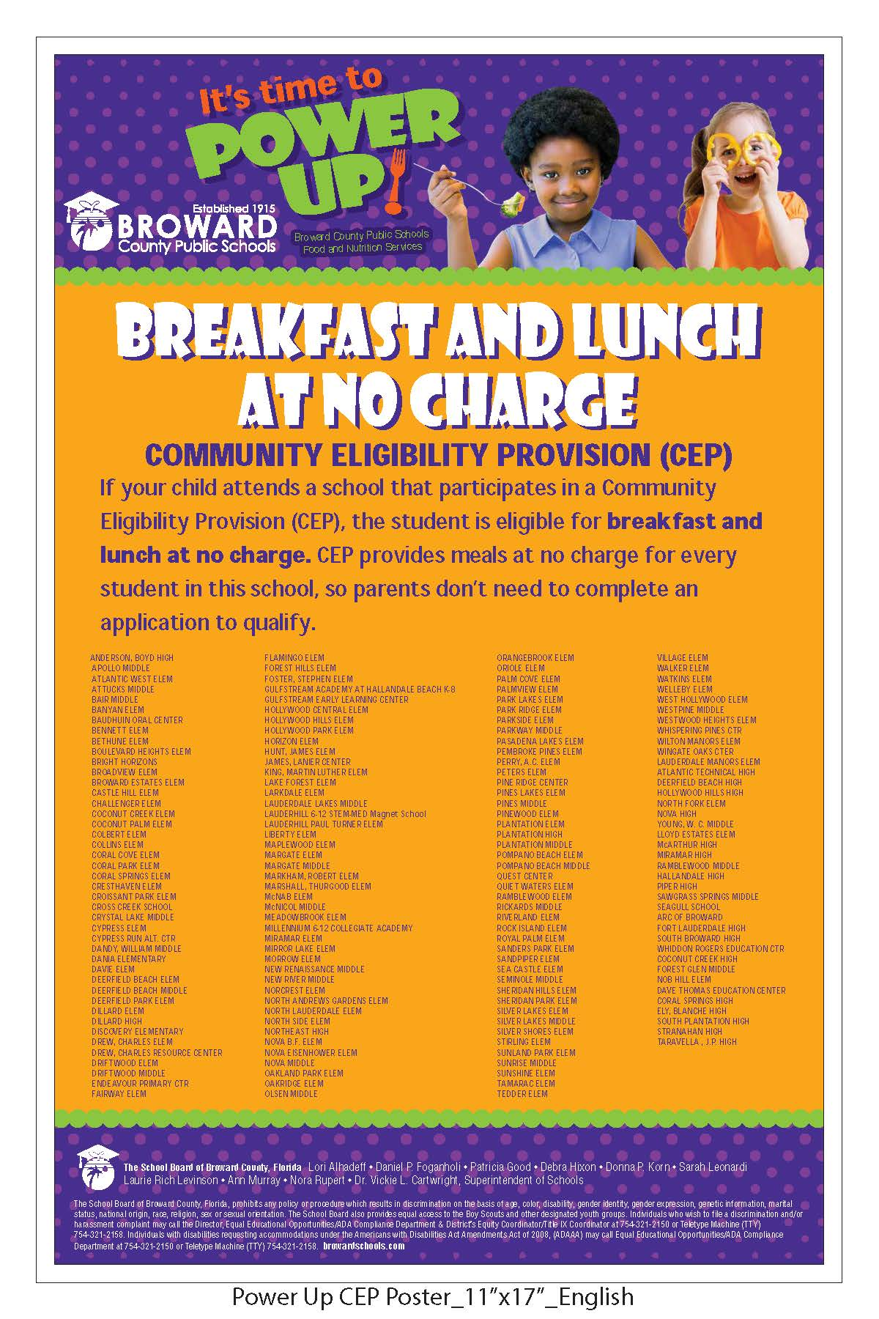
CEP Poster

Slide 23

Non-CEP Poster

